Slide 1
Digital Fundamentals
CHAPTER 7 Latches, Flip-Flops and Timers

Slide 2
Latches
S-R (Set-Reset) latch
Gated S-R latch
Gated D latch
sequential logic. Bistable, monostable, astable
logic devices called multivibrators.
Two categories of bistable devices are the latch and the flip-flop.
Bistable devices have two stable states, called SET and RESET;
The monostable, one-shot, has one state.
A one-shot produces a single controlled-width pulse when activated or triggered.
The astable has no stable state and is used as an oscillator, which is a self-sustained waveform generator.
Pulse oscillators are used as the sources for timing waveforms in digital systems.

Slide 3
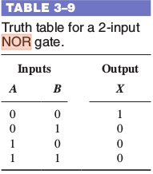
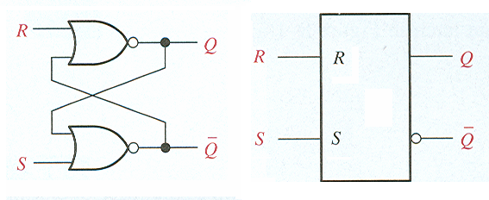
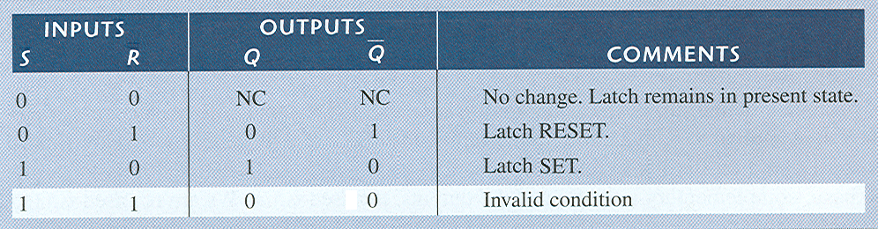
Latches
S-R latch Active High
When the Q output is HIGH, the latch is in the SET state.
When the Q output is LOW, the latch is in the RESET state.
0
1
1
0

Slide 4
Latches
S-R latch Active High
When the Q output is HIGH, the latch is in the SET state.
When the Q output is LOW, the latch is in the RESET state.

Slide 5
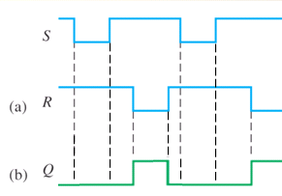
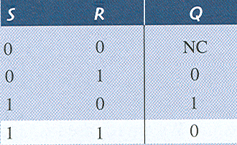
Find the output Q, given the inputs S and R. Assume Q is low initially.
Q goes low when S goes low and R is high. Q goes high when R goes low and S is high. No change if both are low. Q is low if both inputs are low.

Slide 6
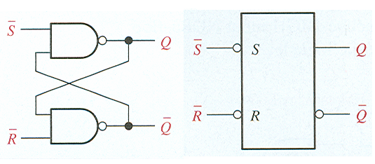
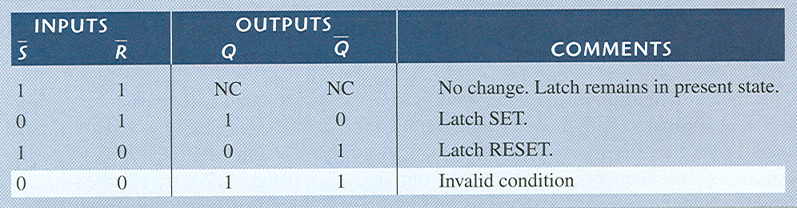
Latches
S-R latch
- Active Low since bubbles on inputs.

Slide 7
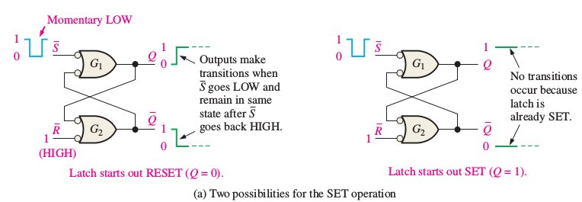
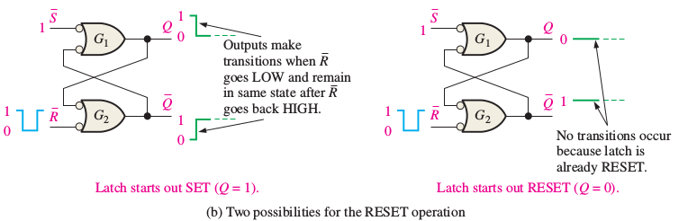
Latches

Slide 8
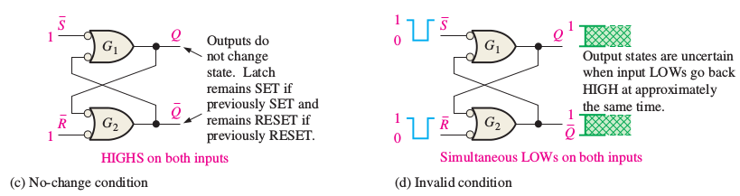
Latches

Slide 9
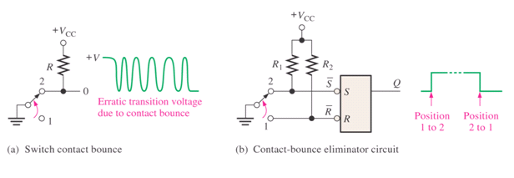
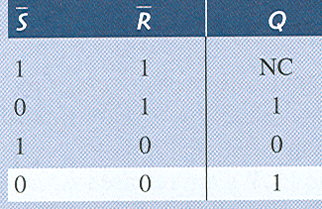
An Application
The Latch as a Contact-Bounce Eliminator
When switch is changed from position 1 to 2, R goes from 0 to 1, while S goes from 1 to 0, 0 to 1, 1 to 0, etc. , but Q will stay at 1 since there is no change if both S and R are 1.

